Slide 1
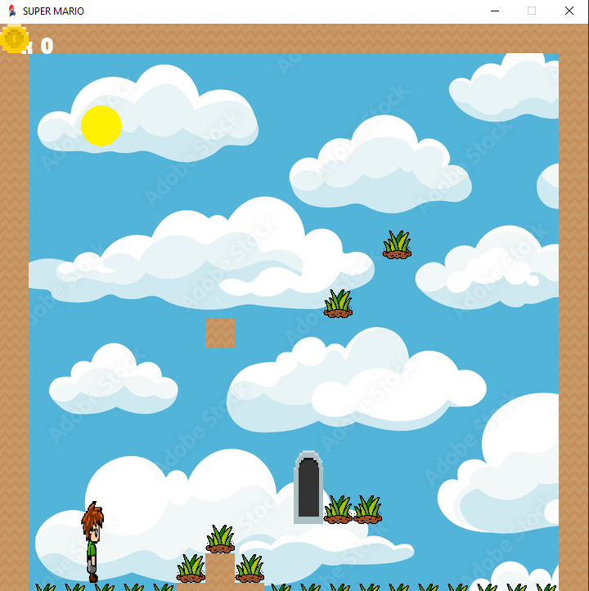
Super Mario Using Pygame Library in Python Sara AlSanajleh

Slide 2
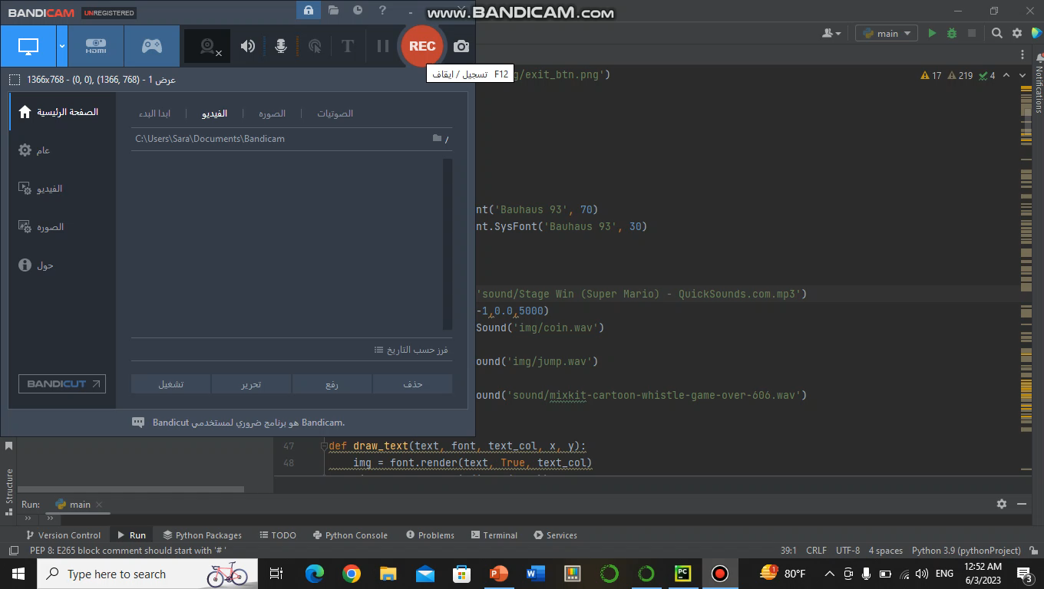
Game video

Slide 3
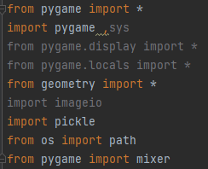
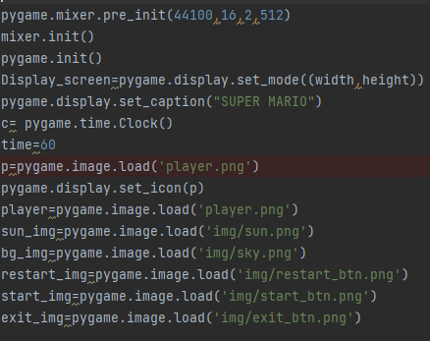





Importing Libraries
pygame.mixer.pre_init
Rate,size,channels, and buffer size
mixer.init()
Must call this function before using the mixer functions.
pygame.init()
Must call this function before using the Pygame functions
Load images

Slide 4
Screen dimensions control
Display_screen=pygame.display.set_mode((width,height))
pygame.display.set_caption("SUPER MARIO")
c= pygame.time.Clock()
time=60

Slide 5
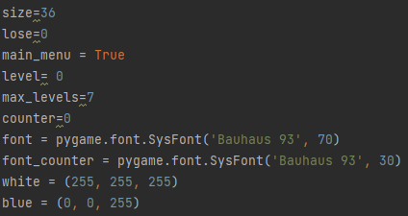
Formatting
Several variables and colors are defined variables are initialized with specific values, and used for specific purposes
pygame.font.SysFont()
Specifies the font name and sizes for rendering text in the game

Slide 6
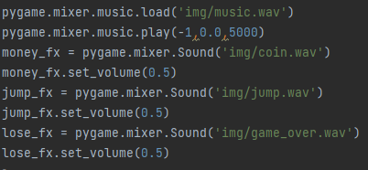
Sounds
Includes downloading and adding sounds to the game and controlling volume levels

Slide 7
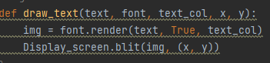
Text
The draw_text function
simplifies the process of rendering and displaying text on the game screen.
It takes several parameters
text
font
text
color
x
y

Slide 8
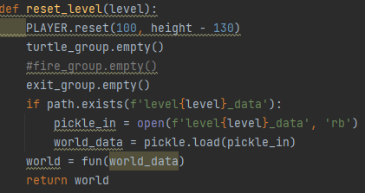
Reset Level
The reset_level function
Responsible for resetting the game level
It takes the level parameter as input
The performed actions
The player's position is reset to a default location at coordinates (100, height - 130), where height is the height of the game screen
The turtle_group, exit_group, and potentially fire_group are emptied
The function then checks if a file named level{level}_data exists, and if so, it loads the corresponding level data using the pickle module and assigns it to world_data
A new instance of the game world is created using the fun function, passing the world_data as an argument

Slide 9
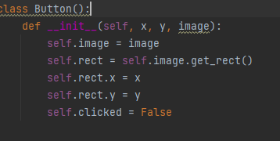
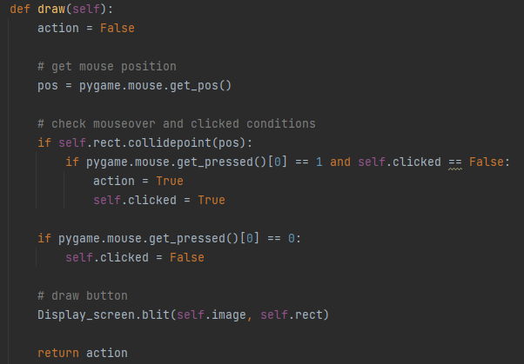
Buttons
The Button class encapsulates the functionality of a clickable button, handling its appearance, click detection, and drawing, providing a convenient way to create interactive buttons in the game

Slide 10
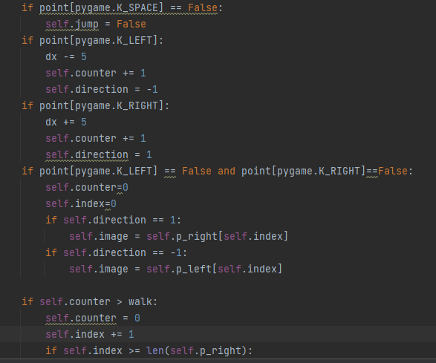

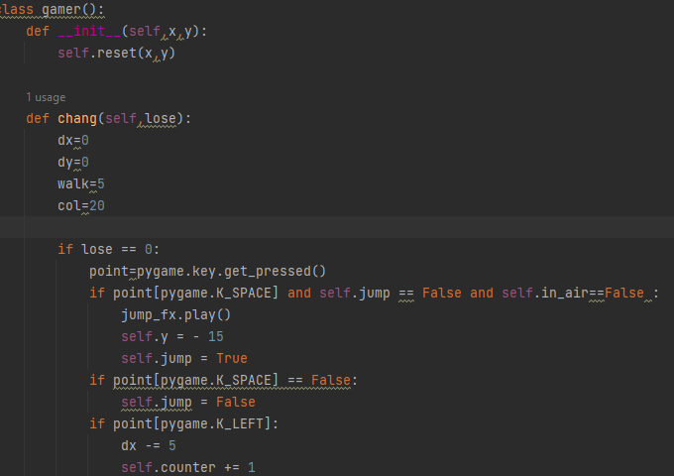

Gamer
The gamer class encapsulates the behavior and attributes of the player character in the game. It handles player movement, animation, collision detection, and game state changes
Player
Dead

Slide 11
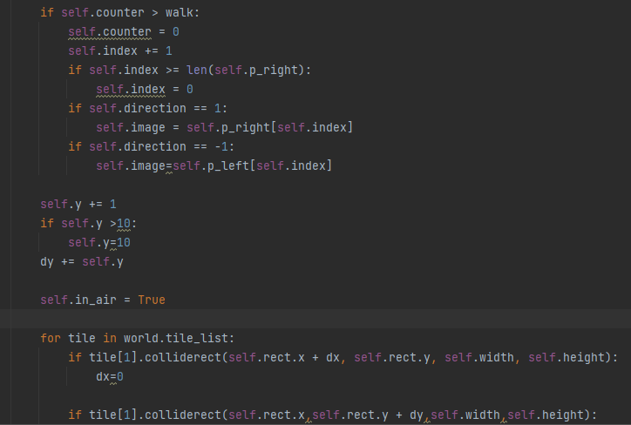
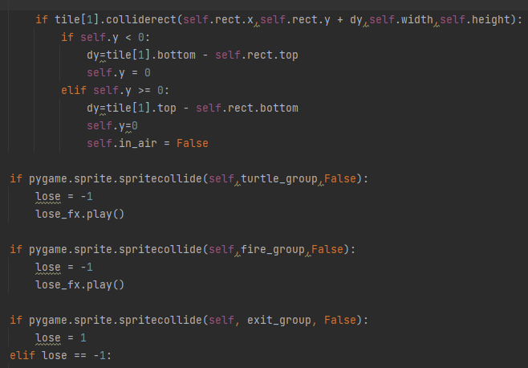
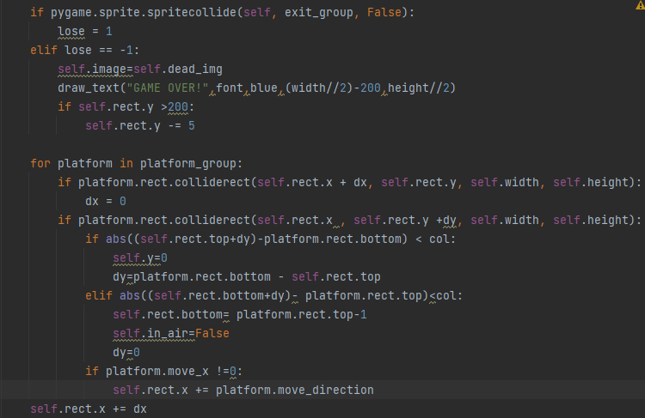
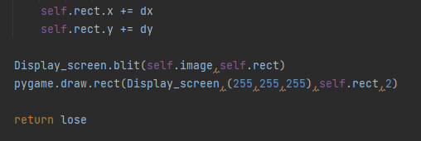
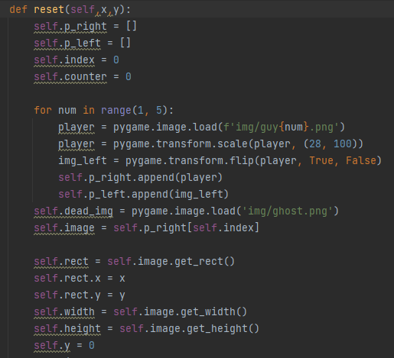

Slide 12
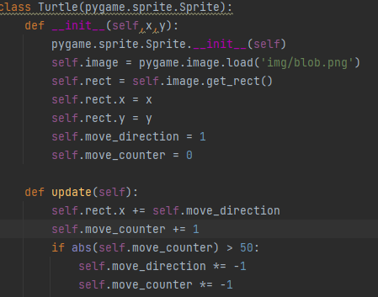

Turtle
Turtle class
encapsulates the behavior and attributes of a turtle enemy. It handles the turtle's movement, position, and update logic
pygame.sprite.Sprite
provides a foundation for creating and managing sprites in games

Slide 13
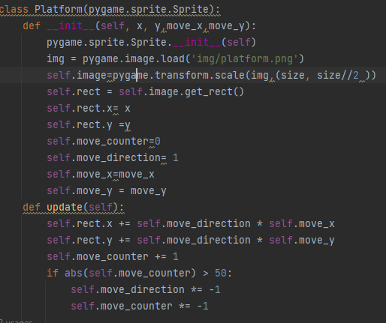
Platform
Platform class encapsulates the behavior and attributes of a platform object. It handles the platform's movement, position, and update logic.

Slide 14
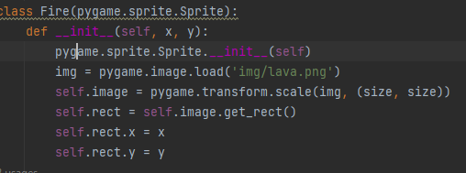
Fire
Fire class encapsulates the behavior and attributes of a fire object. It provides the functionality to display and handle collisions with other sprites in the game.

Slide 15
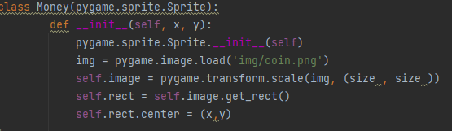
Coin
Money class encapsulates the behavior and attributes of a money/coin object. It provides the functionality to display and handle collisions with other sprites in the game.

Slide 16
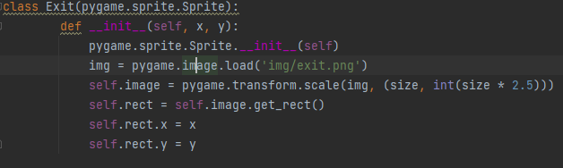
Exit
Exit class encapsulates the behavior and attributes of an exit object. It provides the functionality to display and handle collisions with other sprites in the game, indicating the point where the player can exit the level

Slide 17
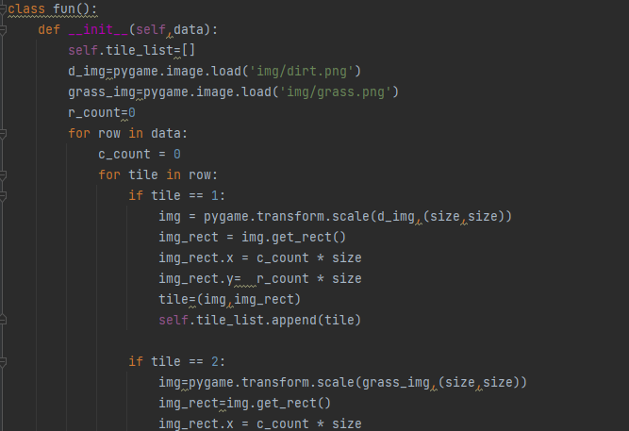
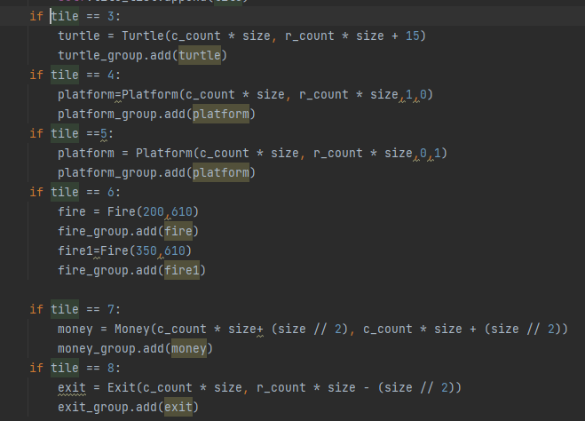
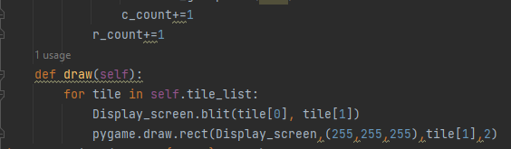
Fun
Fun class is responsible for initializing and managing the game world's tiles and objects based on the provided data, and the draw method handles the visual representation of the tiles on the screen.

Slide 18
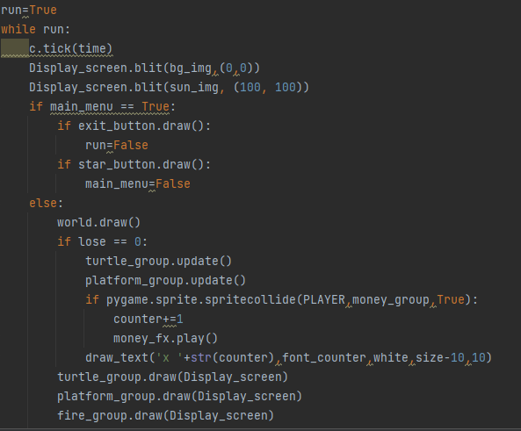
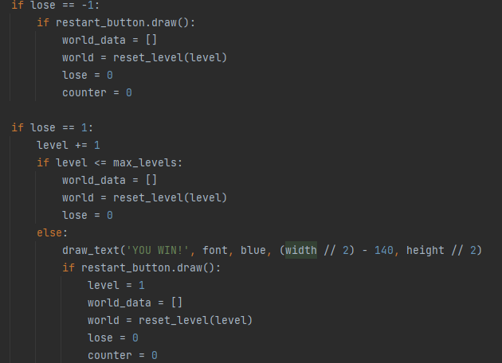
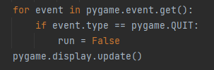
End
The last part of the code is the main game loop that runs until the variable run becomes False. This part of the code ensures the continuous execution of the game, updating the game world, handling player actions, and responding to events until the game is exited or a win/loss condition is met

Slide 19
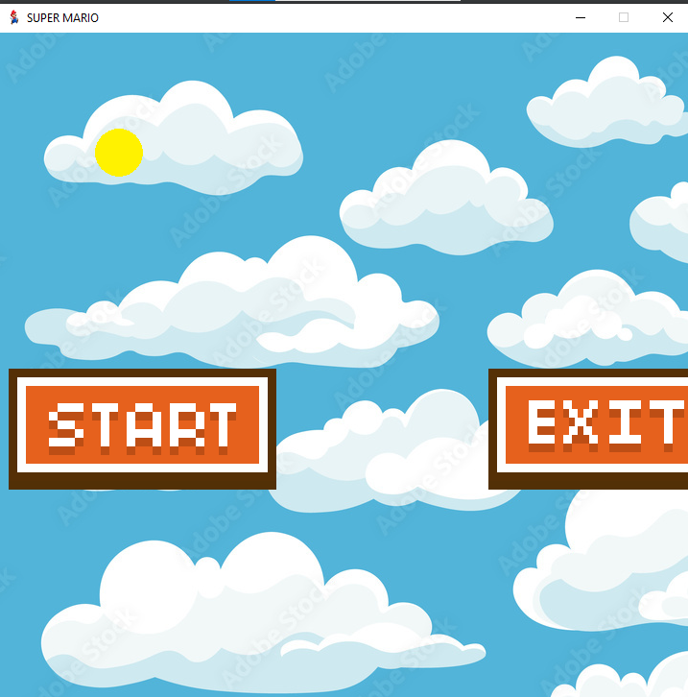
Game Interface Overview

Slide 20
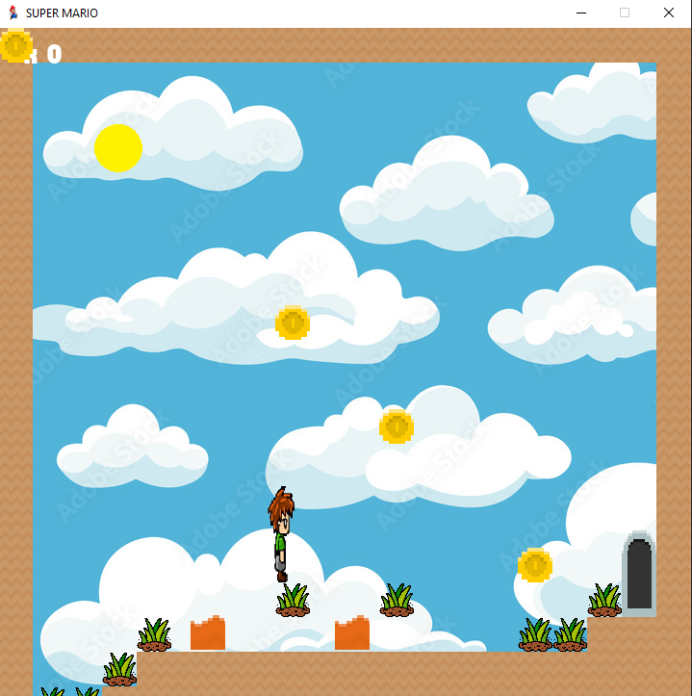
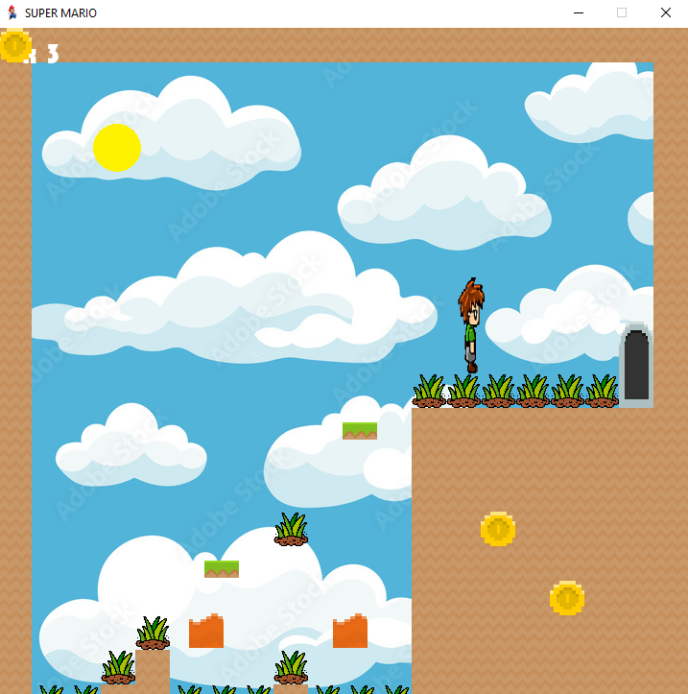

Slide 21
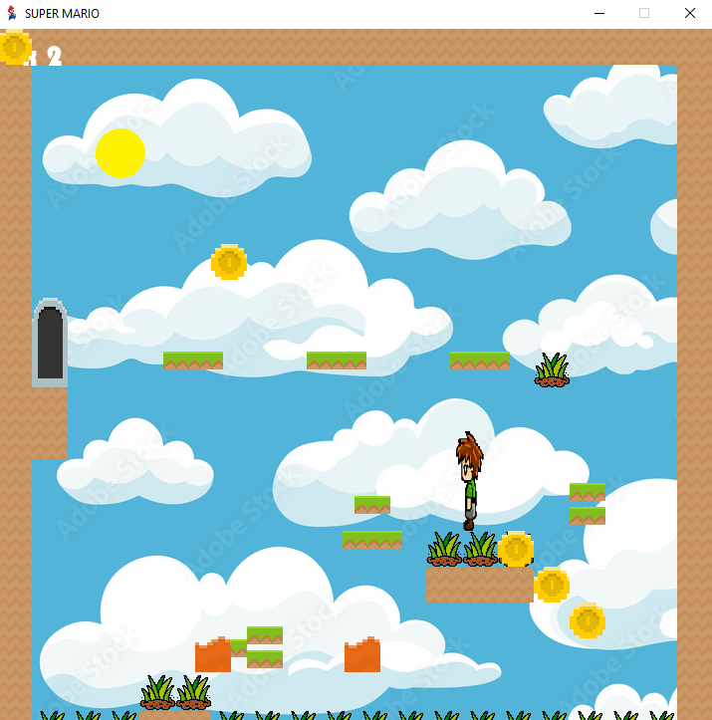
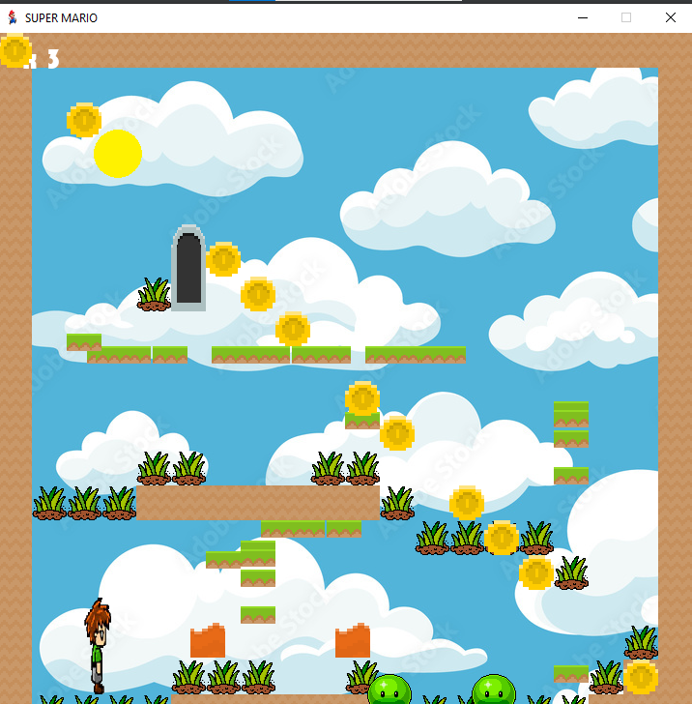

Slide 22
Thank you

